Slide 1
Modular Arithmetic

Slide 2
Modular Arithmetic
Central mathematical concept in cryptography.
It is an arithmetic for integers that focus on the reminder.
Wrap around after reaching a certain value called a modulus.
Definition: “If a is an integer and n is a positive integer, we define a mod n to be the remainder when a is divided by n”. The integer n is called the modulus.
a = qn + r where 0 ≤ r < n; q = [a/n];

Slide 3

Modulus with an analogy
Clock analogy
Notes:
Modular arithmetic or clock arithmetic
For ex, to find 46 mod 12, v could take a rope of 46 units & rap it around a clock of 12 units, which is called as modulus. And where the rope ends is the solution.
So v could say 46 mod 12 is congruent to 10.

Slide 4
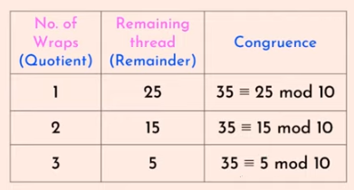
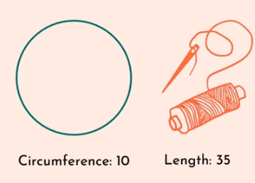
Modulus with an analogy

Slide 5
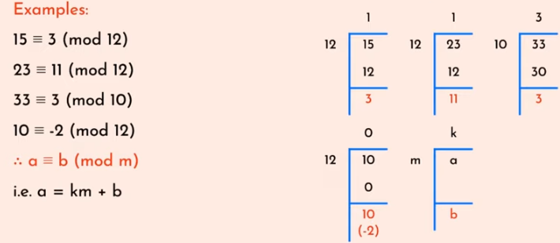
Congruence
In cryptography, congruence (≡) instead of equality (=).

Slide 6
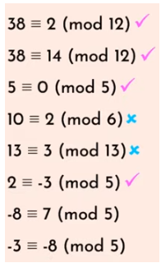
Valid or invalid ?

Slide 7
Properties of Modular Arithmetic
[(a mod n) + (b mod n)] mod n = (a + b) mod n.
[(a mod n) - (b mod n)] mod n = (a - b) mod n.
[(a mod n) x (b mod n)] mod n = (a x b) mod n.

Slide 8
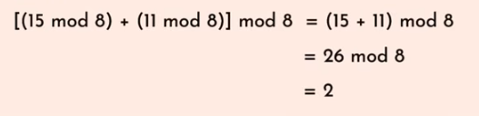
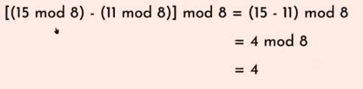
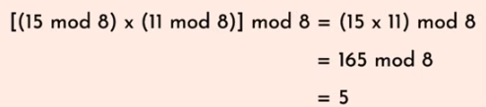
Example

Slide 9
Properties of Modular Arithmetic
Property | Expression
Commutative laws | (a + b) mod n = (b + a) mod n (a x b) mod n = (b x a) mod n
Associative laws | [(a + b) + c] mod n = [a + (b + c)] mod n [(a x b) x c] mod n = [a x (b x c)] mod n
Distributive law | [a x (b + c)] mod n = [(a x b) + (a x c)] mod n
Identities | (0 + a) mod n = a mod n (1 x a) mod n = a mod n
Additive inverse | For each a ∈ Zn, there exists a ‘-a’ such that a + (-a) ≡ 0 mod n

Slide 10
Exercise
18 mod 12
24 mod 12
32 mod 12
4 mod 12
8 mod 12

Slide 11
Properties of Congruence
a ≡ r (mod n) if r is the remainder obtained by dividing a by n.
Reflexivity : a ≡ a (mod n)
Symmetry:
a ≡ b (mod n) implies b ≡ a (mod n)
Transitivity:
a ≡ b (mod n) and b ≡ c (mod n) implies
a ≡ c (mod n).

Slide 12
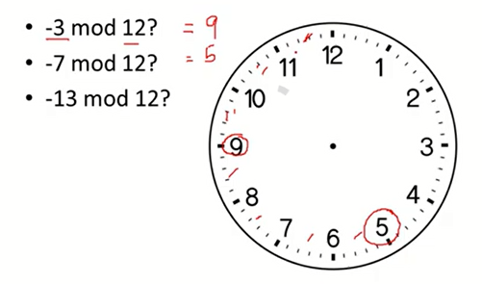
Points to remember
N mod M = Remainder.
If N is less than M then N mod M = N.
For negative numbers consider anti-clockwise direction.

